Slide 1
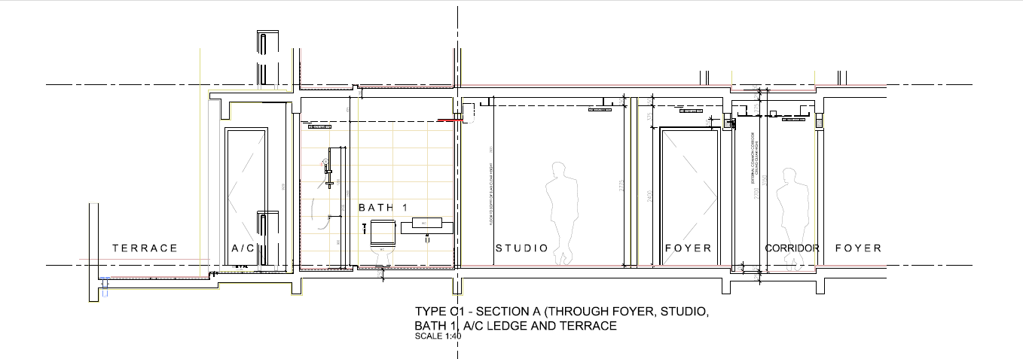
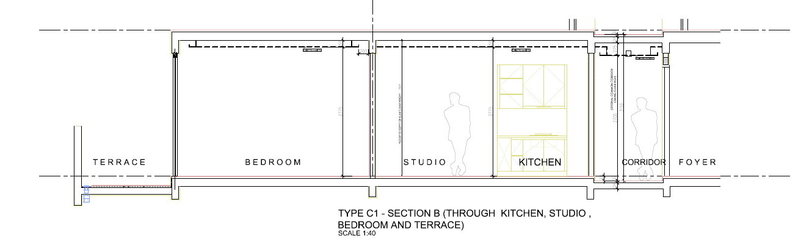
Figure 1: Section through foyer, studio, bath 1, a/c ledge and terrace.
Figure 2: Section through kitchen, studio, bedroom and terrace.
The figure 1 & 2 shown that cross ventilation at typical units.

