Slide 1
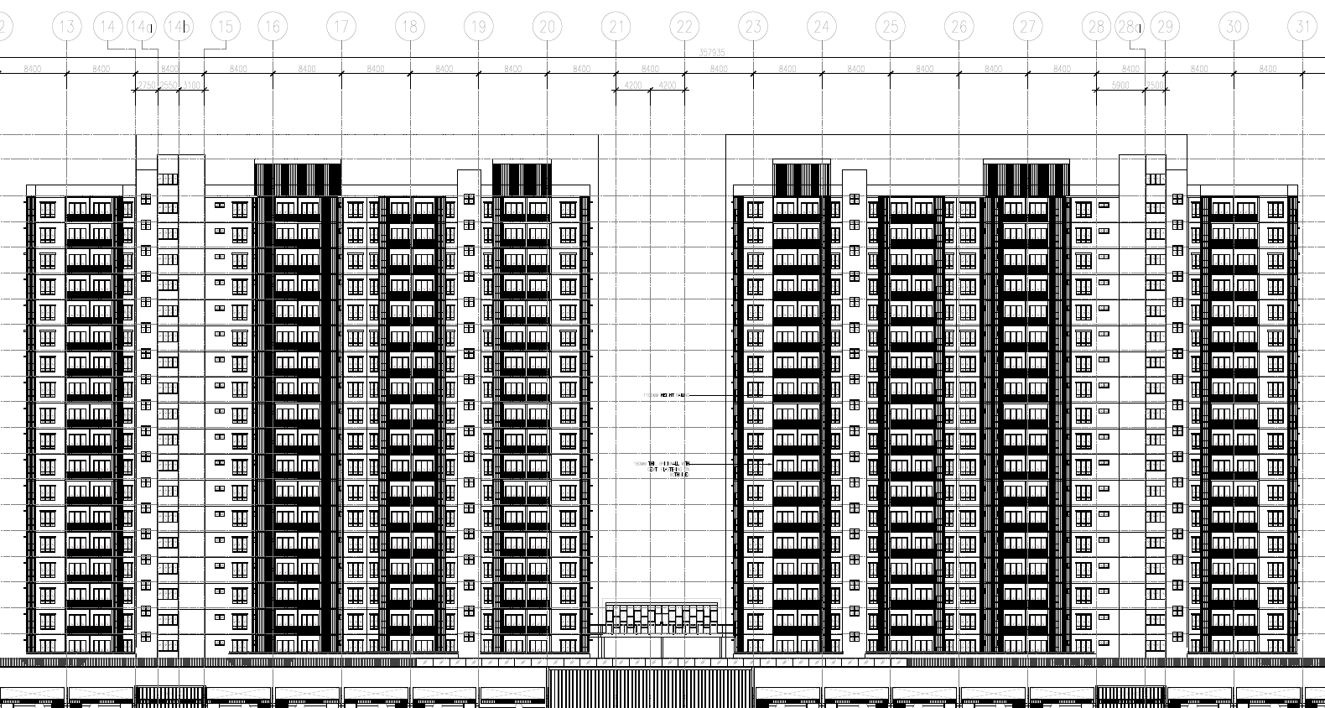
External wall with VOC paint
Figure : The red demarcation shown the external wall with VOC paint.
VOC paint at external wall.

Slide 2
Roof with VOC paint
VOC paint at roof.

Slide 3
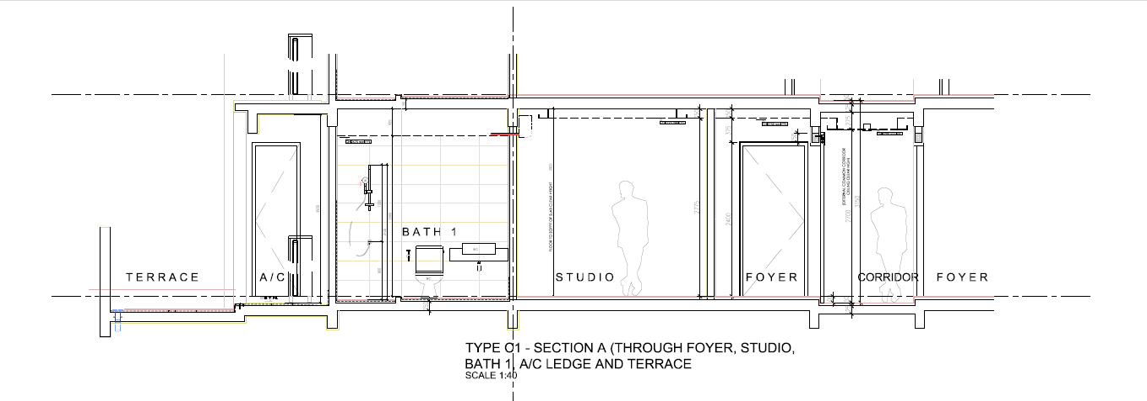
VOC paint at ceiling
VOC paint at wall

Slide 4
Type A
Low VOC paint surface
Wall Surface - (1.3 + 1.8 + 1.65 +0.525 + 9.185 + 0.575 + 0.31 + 7.275 + 1.425) x 3m = 72.135 sqm
Ceiling Surface =43.93 sqm
Floor Surface = 0 sqm (tile/ Vinyl)
Total Surface
Wall Surface – (1.3 + 1.8 +1.65 + 0.525 + 9.185 + 0.575 + 0.31 + 7.275 + 1.425 + 2.675 + 4.25 + 4.25 + 2.8 + 2.675) x 3m = 122.085 sqm
Ceiling surface = 43.93 sqm
Floor Surface= 43.93 sqm
% VOC for wall surface
(72.135 sqm / 122.085 sqm) x 100 = 59.09%
% VOC for Ceiling surface
(43.93 sqm / 43.93 sqm) x 100 = 100%

Slide 5
Type B
Low VOC paint Surface
Wall Surface – (6.9 + 2.8 + 8.81 + 1.625 + 1.025 + 0.55 + 3.3 + 4.25 + 6.24 + 8.36) x 3 m = 131.58 sqm
Ceiling Surface - 64.85 sqm
Floor Surface – 0 sqm (tile/Vinyl)
Total Surface
Wall Surface - (6.91 + 2.8 + 8.81 + 1.625 + 1.025 + 0.55 + 3.3 + 4.25 + 6.24 + 8.36 + 2.3 + 7.1 + 7.1) x 3 m = 181.11 sqm
Ceiling = 64.85 sqm
Floor = 64.85 sqm
% VOC for wall surface
(131.58 sqm / 152.91 sqm) x 100 = 72.65%
% VOC for Ceiling surface
(64.85 sqm / 64.85 sqm) x 100 = 100%

Slide 6
Type C
Low VOC paint Surface
Wall Surface – (9.185 + 1.75 + 1.6 + 1.0 + 1.3 + 7.2 + 3.45 + 7.85 + 1.75 + 0.575 + 2.325 + 3.46) x 3 m = 124.335 sqm
Ceiling Surface = 64.50 sqm
Floor Surface = 0 sqm (Tile/Vinyl)
Total Surface
Wall Surface - (9.185 + 1.75 + 1.6 + 1.0 + 1.3 + 7.2 + 3.45 + 7.85 + 1.75 + 0.575 + 2.325 + 3.46 + 3.375 + 3.175 + 7.15 + 7.15) x 3 m = 186.885 sqm
Ceiling Surface = 64.50 sqm
Floor surface = 64.50 sqm
% VOC for wall surface
(124.335 sqm / 186.885 sqm) x 100 = 66.53%
% VOC for Ceiling surface
(64.50 sqm / 64.50 sqm) x 100 = 100%

