Slide 1
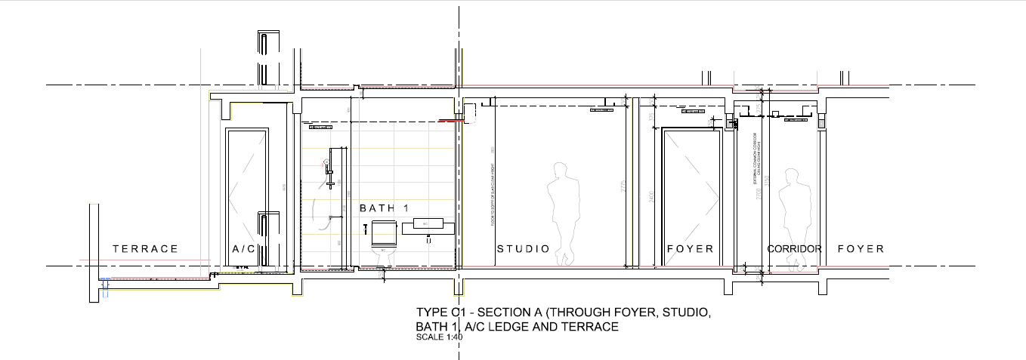
Views from interior
Figure 1: Section shown that the view from interior.
Views from interior
Figure 2: Section shown that the view from interior.

Slide 2
Views from room
Views from living room

Slide 3
Views from room
Views from living room
Views from room

Slide 4
Views from living room
Views from room

