Slide 1
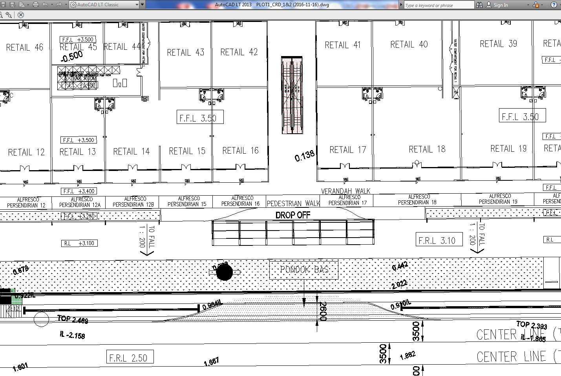
Walkway
Bus Stop
Figure 2: shown the bus stop location within the site

