Slide 1
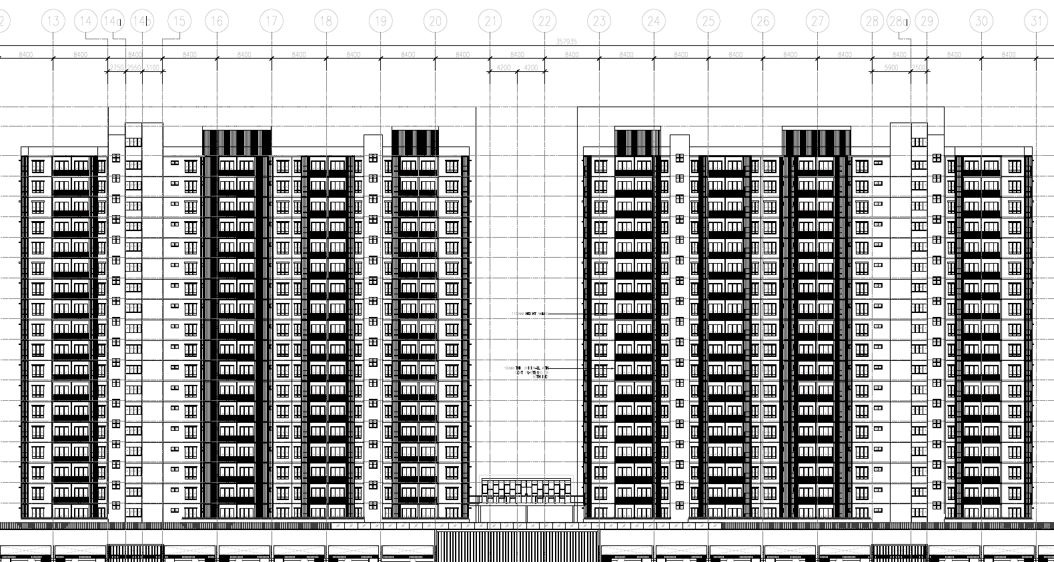
External wall with VOC paint
Figure : The red demarcation shown the external wall with VOC paint.
VOC paint at external wall.

Slide 2
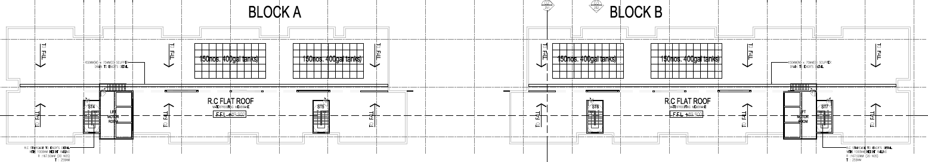
Roof with VOC paint
VOC paint at roof.

Slide 3
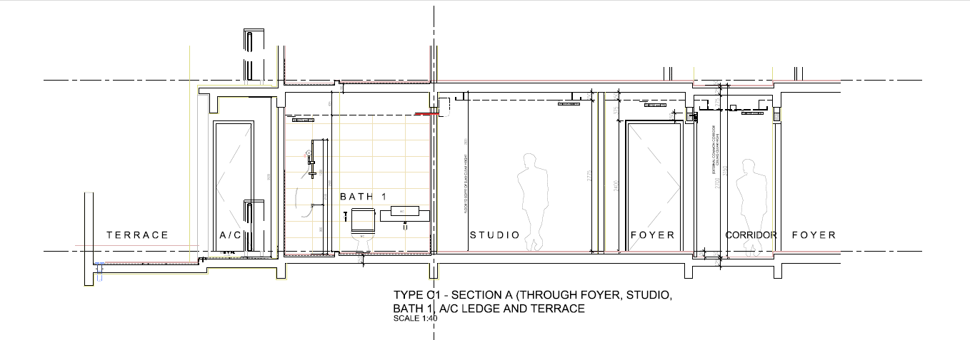
VOC paint at ceiling
VOC paint at wall

Slide 4
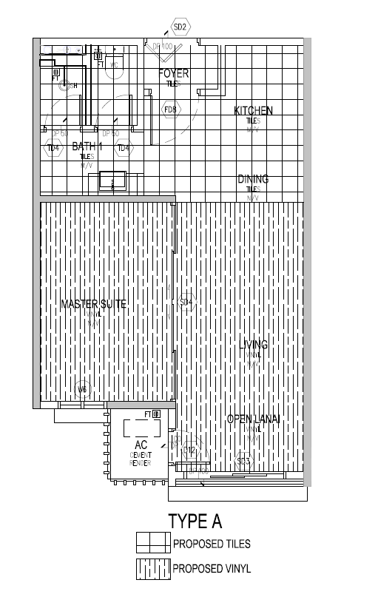
Type A
Low VOC paint surface
Wall Surface - (30.695 + 0.25 + 2.875) x 3m = 101.46 sqm
Ceiling Surface =43.93 sqm
Floor Surface = 0 sqm (tile/ Vinyl)
Total Surface
Wall Surface – 40.695 x 3m = 122.085 sqm
Ceiling surface = 43.93 sqm
Floor Surface= 43.93 sqm
% VOC for wall surface
(101.46 sqm / 122.085 sqm) x 100 = 83.11%
% VOC for Ceiling surface
(43.93 sqm / 43.93 sqm) x 100 = 100%

Slide 5
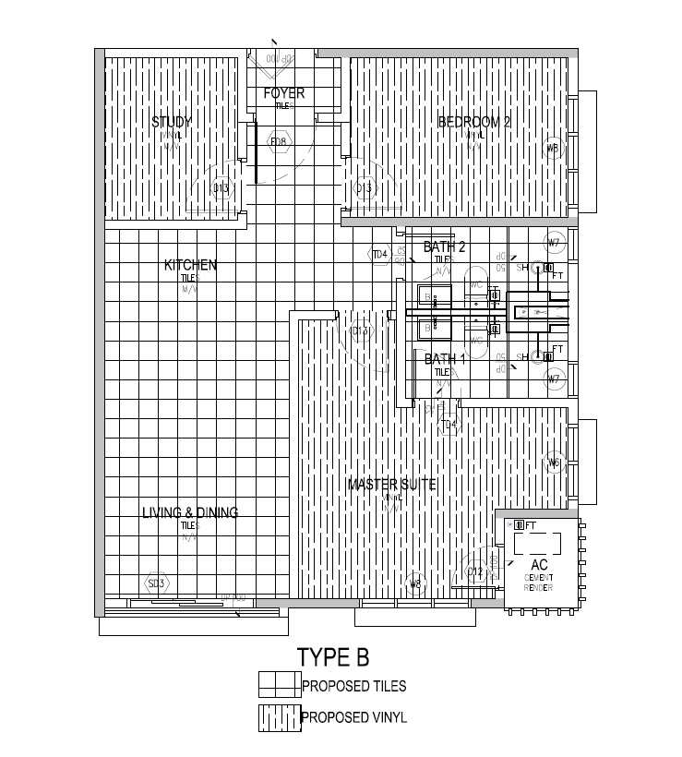
Type B
Low VOC paint Surface
Wall Surface – (40.70 + 6.275 + 2.50 + 3.875) x 3 m = 160.05 sqm
Ceiling Surface - 64.85 sqm
Floor Surface – 0 sqm (tile/Vinyl)
Total Surface
Wall Surface – 60.37 x 3 m = 181.11 sqm
Ceiling = 64.85 sqm
Floor = 64.85 sqm
% VOC for wall surface
(160.05 sqm / 181.11 sqm) x 100 = 72.65%
% VOC for Ceiling surface
(64.85 sqm / 64.85 sqm) x 100 = 100%

Slide 6
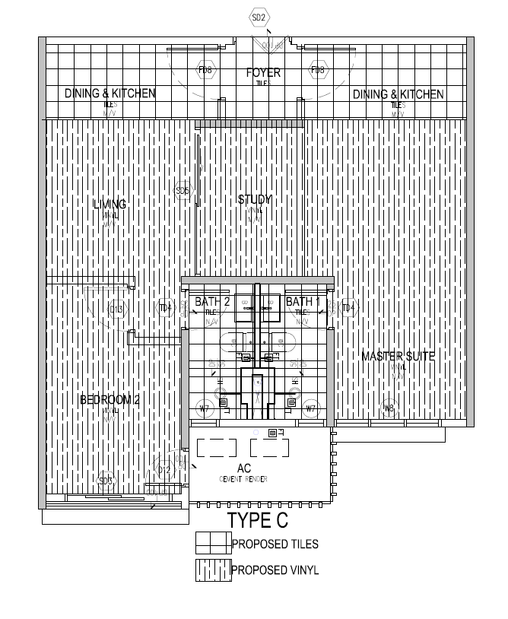
Type C
Low VOC paint Surface
Wall Surface – (43.25 + 2.95 + 3.9) x 3 m = 150.30 sqm
Ceiling Surface = 64.50 sqm
Floor Surface = 0 sqm (Tile/Vinyl)
Total Surface
Wall Surface - 62.295 x 3 m = 186.885 sqm
Ceiling Surface = 64.50 sqm
Floor surface = 64.50 sqm
% VOC for wall surface
(150.30 sqm / 186.885 sqm) x 100 = 80.42%
% VOC for Ceiling surface
(64.50 sqm / 64.50 sqm) x 100 = 100%

